Slide 1
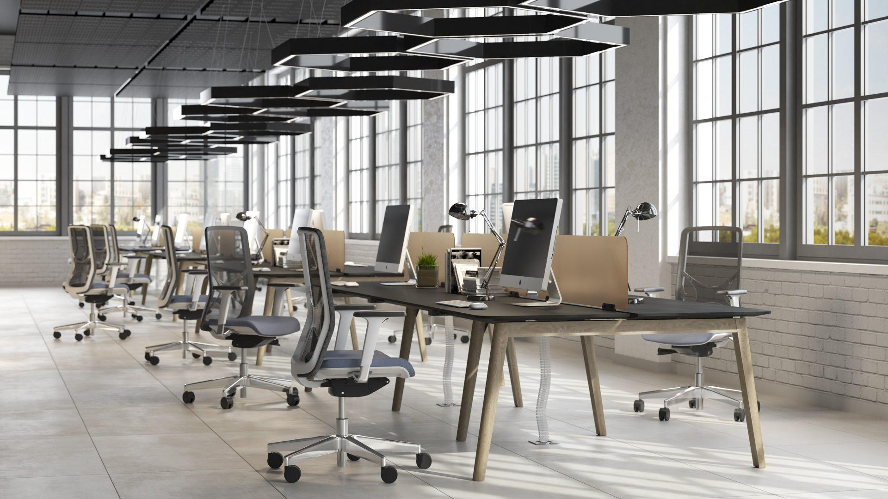
NOVA WOOD
WORKSTATION + DESK SYSTEM

Slide 2
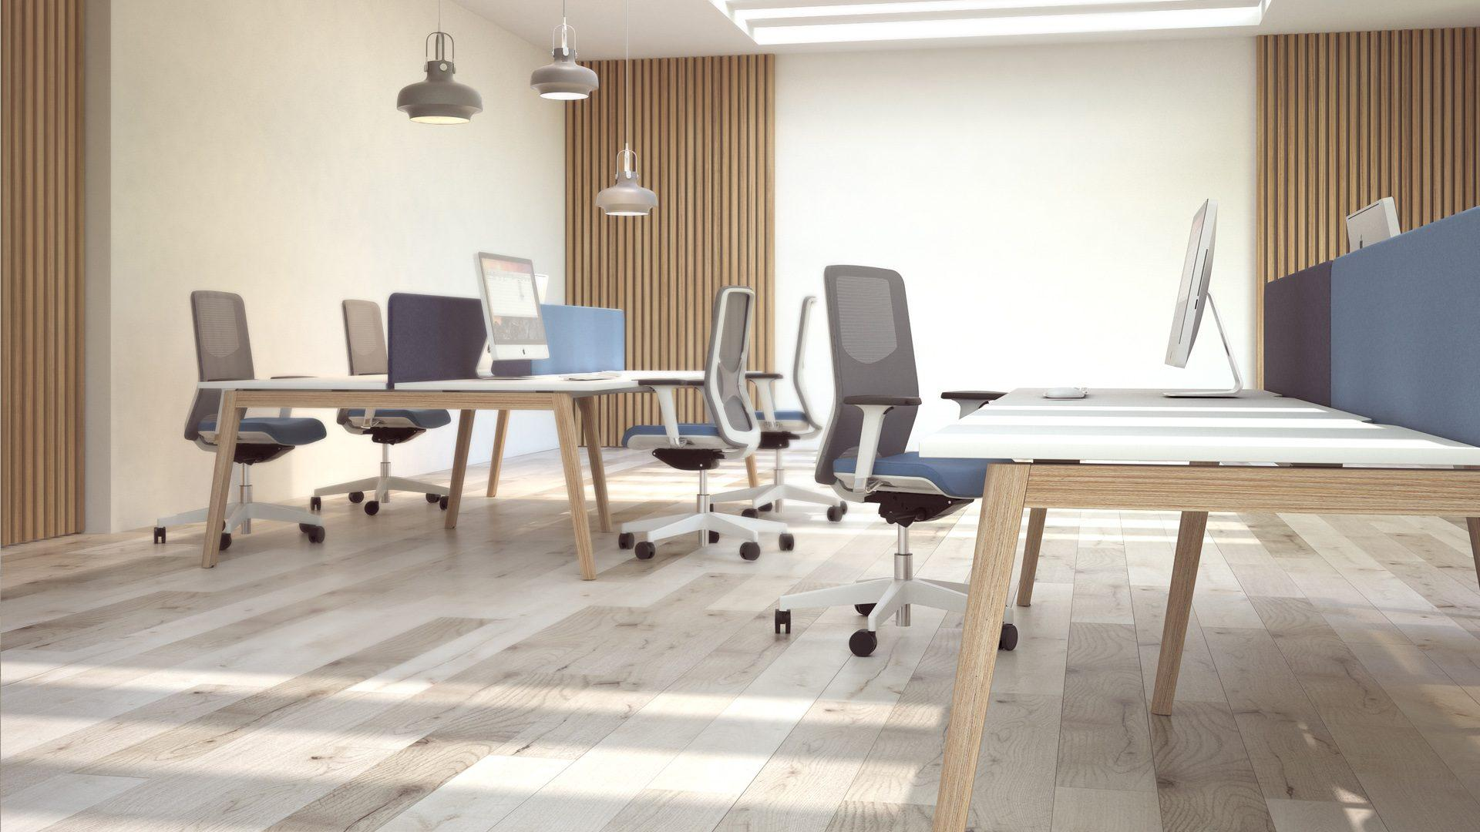
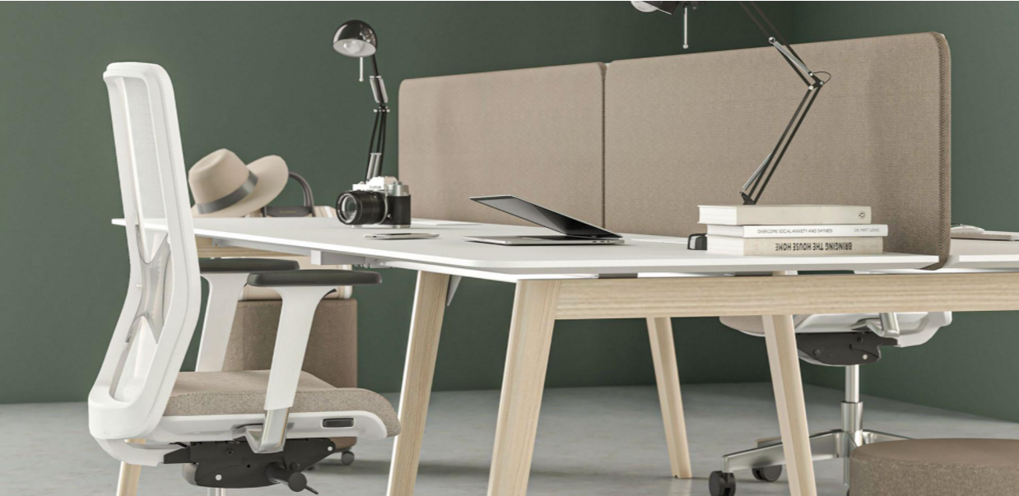
Creating Work[ing] Spaces
1800 549 852
sales@interiasystems.com.au
NOVA WOOD
WORKSTATION + DESK SYSTEM
A touch of nature in your office!
NOVA Wood is a desking system that adds a delicate sense of luxury to your office and brings you closer to nature and home atmosphere!
The NOVA Wood desking system is ideal for open plan offices where you can arrange different areas for individual or collaborative work, meetings and leisure activities.
WORKTOPS
FRAME
Oak
SPECIFICATIONS
WORKTOP DIMENSIONS: 1500 or 1800mm Long x 600 or 800mm Deep. Other sizes available on request.
WARRANTY: 10 years

Slide 3
Creating Work[ing] Spaces
1800 549 852
sales@interiasystems.com.au
CONFIGURATIONS
Single
Back to Back Cluster - 2, 4, 6 or 8 person
L Shaped
Single
Back to Back Cluster - 2, 4, 6 or 8 person
L Shaped
Single
Back to Back Cluster - 2, 4, 6 or 8 person
L Shaped
Single
Back to Back Cluster - 2, 4, 6 or 8 person
L Shaped

Slide 4
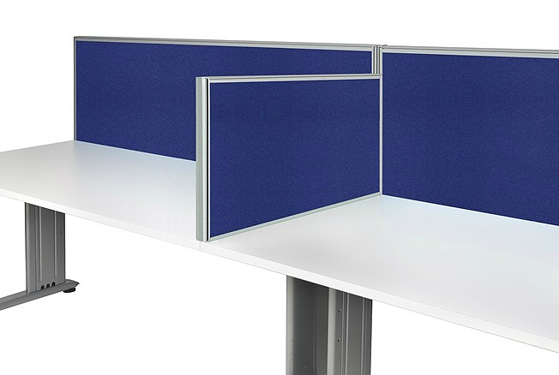
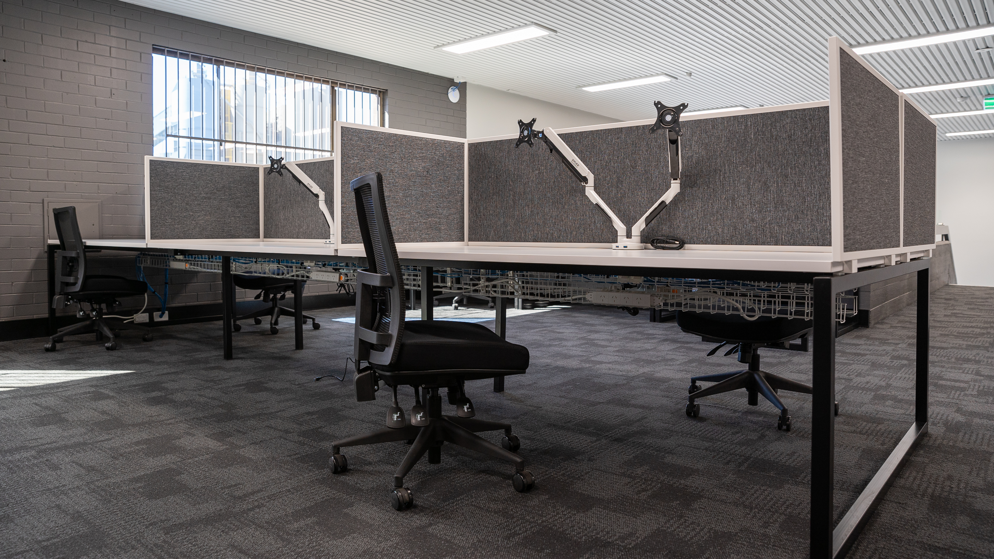
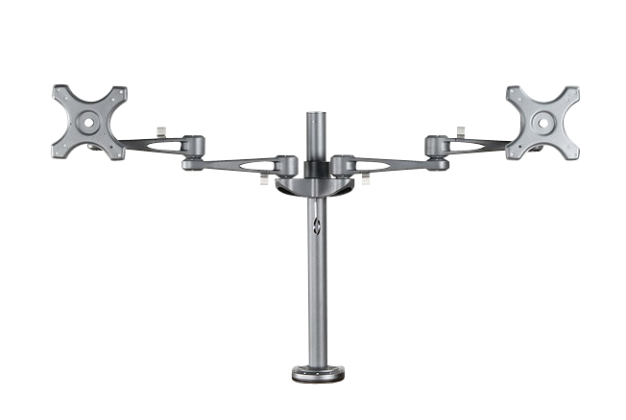
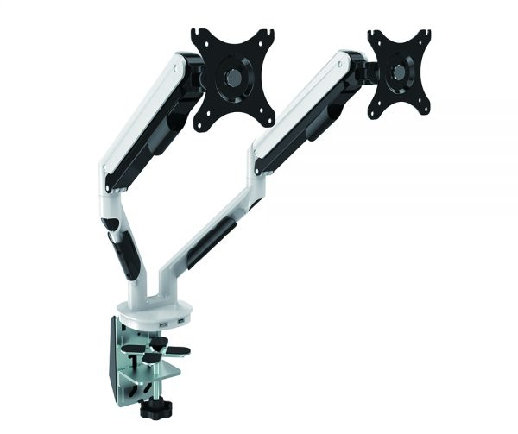
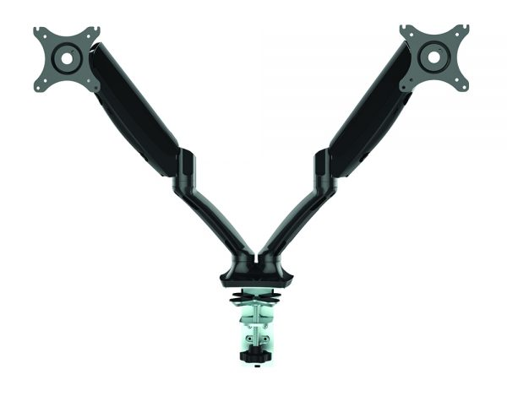
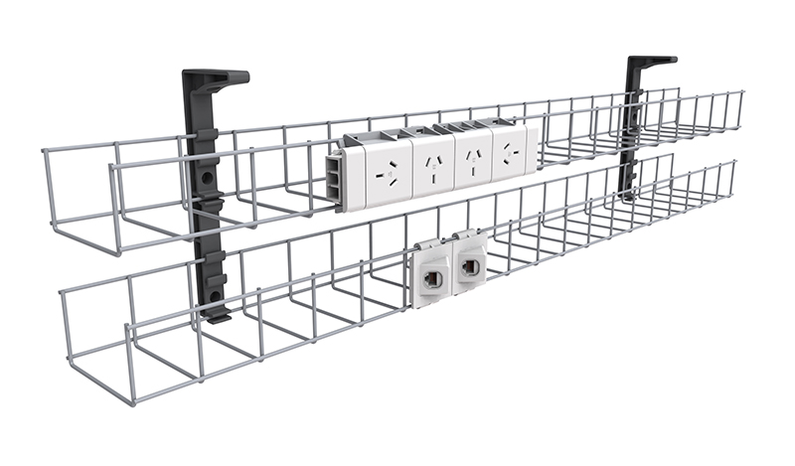
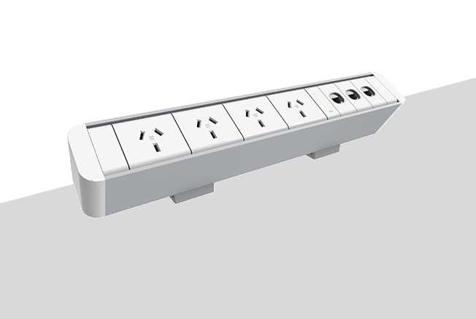
Creating Work[ing] Spaces
1800 549 852
sales@interiasystems.com.au
SCREEN TYPES AND ACCESSORIES
Prestio Fabric Screen
Denver PET Screen
Linq Perspex Screen
Desk760 Fabric Screen
Nova Fabric Screen
Linq Screen Mounted Accessories
Aero Monitor Arm
Cutlass Monitor Arm
Gladius Monitor Arm
Rapido Below Desk Power & Data
Rapido Above Desk Power & Data
Rapido In Desk Phone Charger

